Slide 1
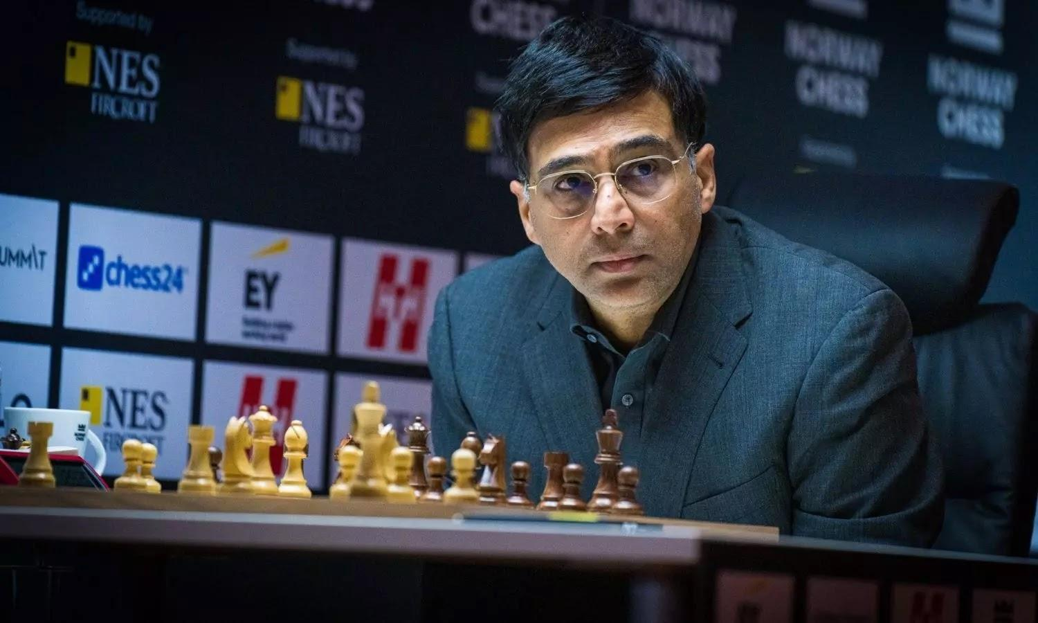
Chess Piece Detection
16-GOSHER ZENIL
17-GUJAR PARTH
24-JAIN JAYESH

Slide 2
Abstract
The game of chess was discovered over 2000 years ago. An ancient game of strategy which captivates the world even today.
We intend to detect and recognise the chess pieces on the chessboard and assign a confidence score to each prediction.
We have use kaggle dataset.
We use a pre-trained model using YOLOV3 (You Only Look Once) which is used with ImageAI library and implemented using transfer learning methodology for custom object detection and recognition.

Slide 3
Introduction
Chess is played between two players: White and Black.
The two players alternate turns (White always moves first), moving one piece at a time with the ultimate goal of capturing the enemy king.
There are six pieces in chess, each moves in a unique way..All pieces do share some common traits. For instance, no piece is allowed to land on a square occupied by a friendly piece.
If a piece lands on a square occupied by an enemy piece, that enemy is captured and removed from the board
Also, with the exception of the knight, pieces are not permitted to jump over other pieces.

Slide 4
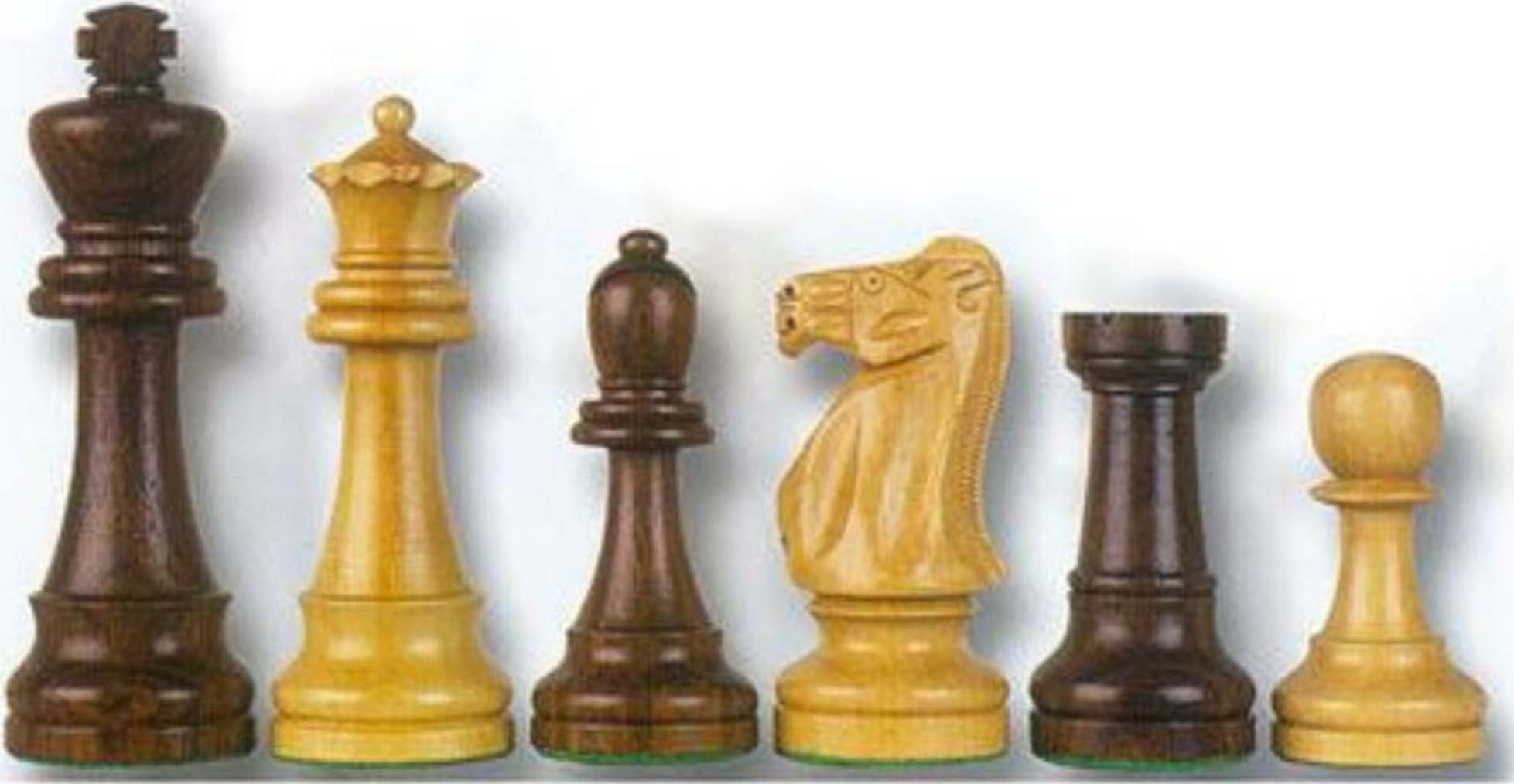
Chess pieces
KING QUEEN BISHOP KNIGHT ROOK PAWN

Slide 5
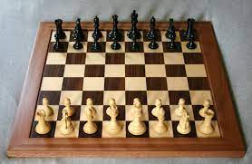
Technology Stack
Python
Kaggle
YOLO V3
A chessboard with all the pieces.

Slide 6
Libraries used
NumPy is a library for the Python programming language, adding support for large, multi-dimensional arrays and matrices, along with a large collection of high-level mathematical functions to operate on these arrays.
PIL Python Imaging Library is a free and open-source additional library for the Python programming language that adds support for opening, manipulating, and saving many different image file formats
ImageAI is a python library built to empower developers, reseachers and students to build applications and systems with self-contained Deep Learning and Computer Vision capabilities.

Slide 7
Algorithm
YOLOv3 (You Only Look Once, Version 3) is a real-time object detection algorithm that identifies specific objects in videos, live feeds, or images. The YOLO machine learning algorithm uses features learned by a deep convolutional neural network to detect an object
The inputs is a batch of images of shape (m, 416, 416, 3).
YOLO v3 passes this image to a convolutional neural network (CNN).
Finally, we do the IoU (Intersection over Union) and Non-Max Suppression to avoid selecting overlapping boxes.

Slide 8
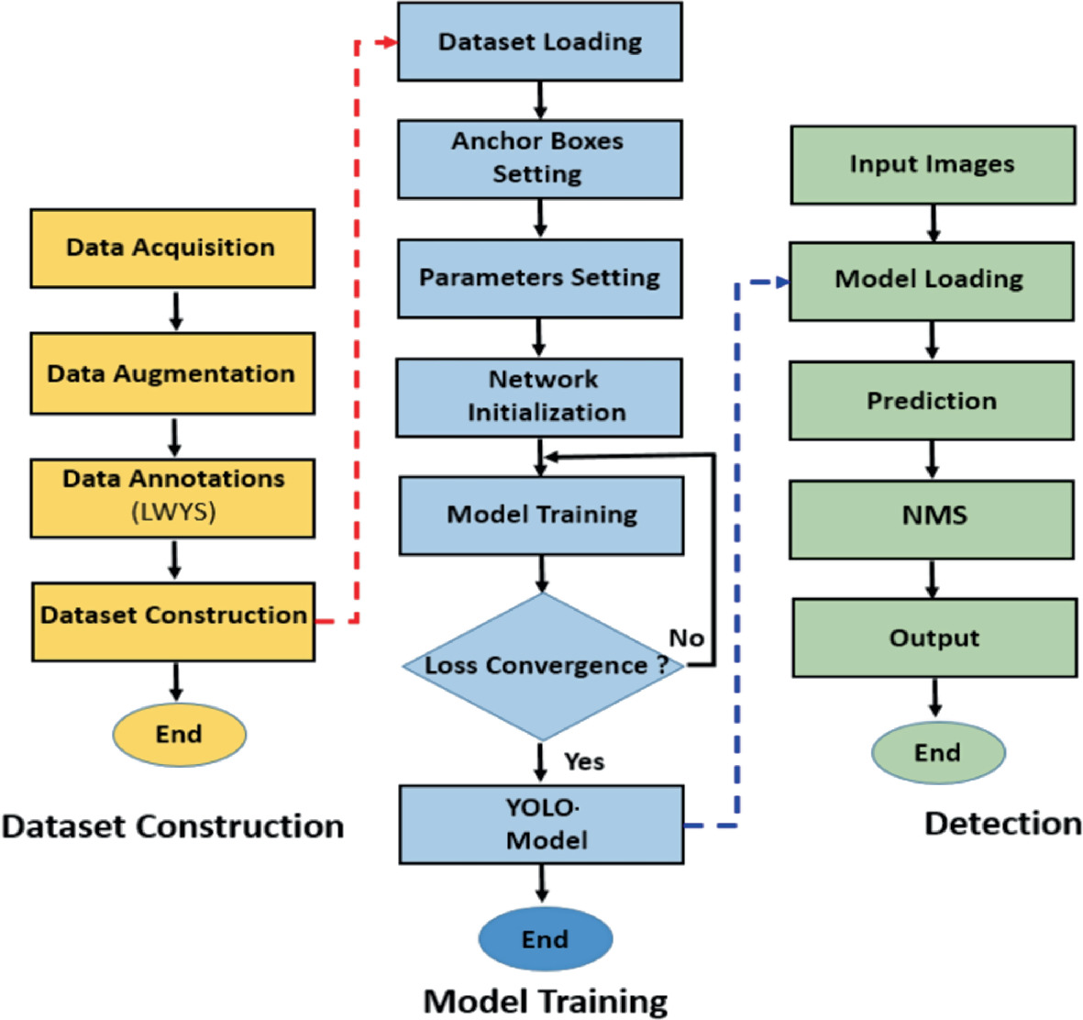
Data Flow Diagram

Slide 9
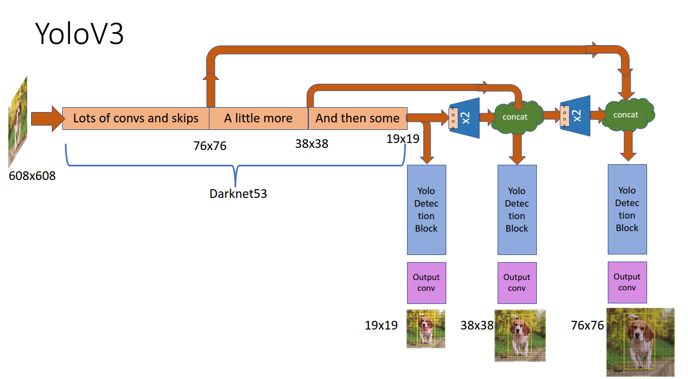
Architecture : YoloV3

Slide 10
Prediction features
Anchor Boxes
Although anchor boxes, or bounding boxes,. Object detectors using YOLOv3 usually predict log-space transforms, which are offsets to predefined “default” bounding boxes. Those specific bounding boxes are called anchors. The transforms are later applied to the anchor boxes to receive a prediction. YOLOv3 in particular has three anchors. This results in the prediction of three bounding boxes per cell.
Non-Maximum Suppression
Objects can sometimes be detected multiple times when more than one bounding box detects the object as a positive class detection. Non-maximum suppression helps avoid this situation and only passes detections if they haven’t already been detected. Using the NMS threshold value and confidence threshold value, NMS is implemented to prevent double detections. It is an imperative part of utilizing YOLOv3 effectively.

Slide 11
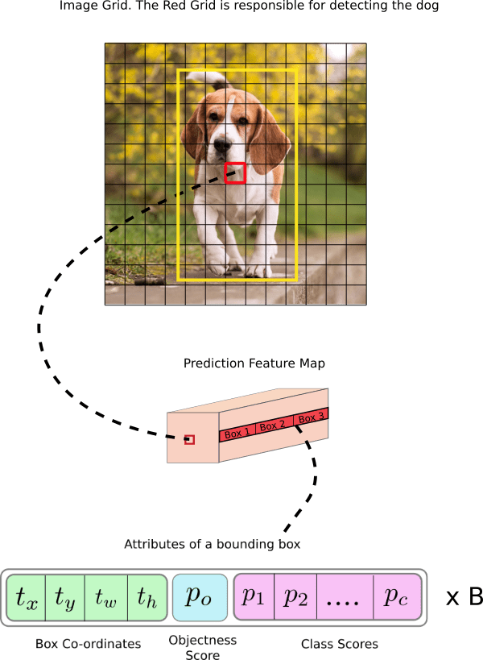
Bounding boxes and Non-maximum Suppression (NMS)

Slide 12
Evaluation
Class Confidence and Box Confidence Scores
Each bounding box has an x, y, w, h, and box confidence score value. The confidence score is the value of how probable a class is contained by that box, as well as how accurate that bounding box is.

Slide 13
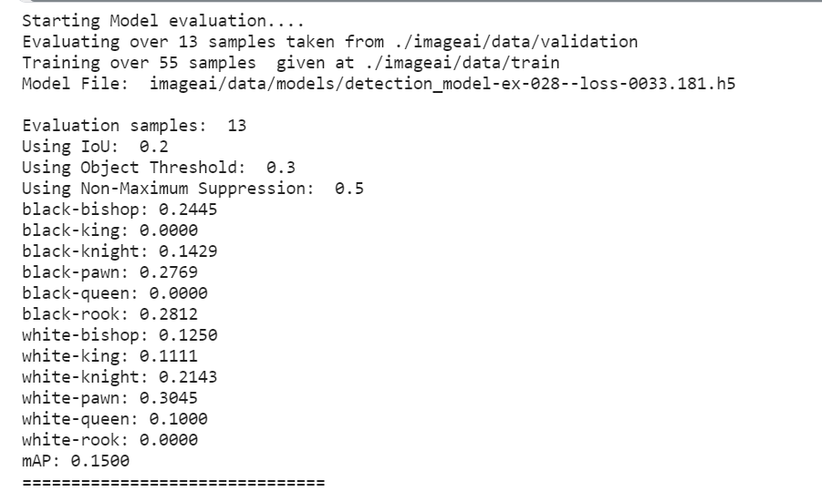
Model Evaluation

Slide 14
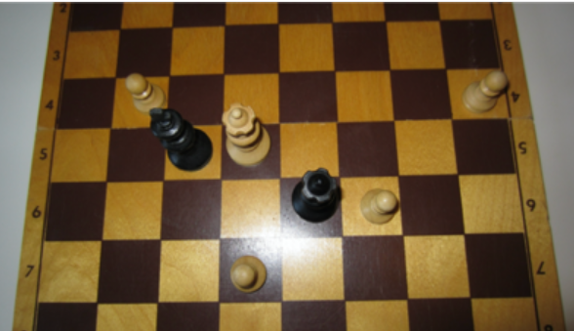
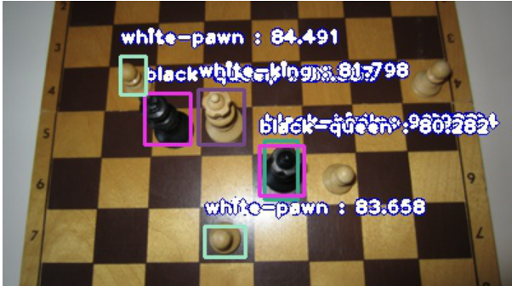
Output

Slide 15
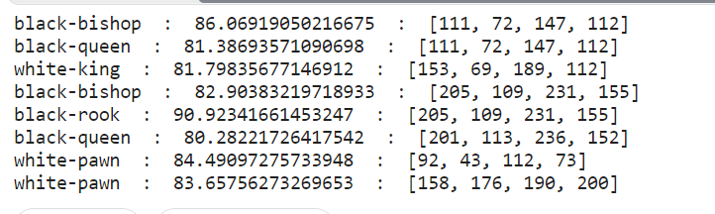
Probability Matrix

Slide 16
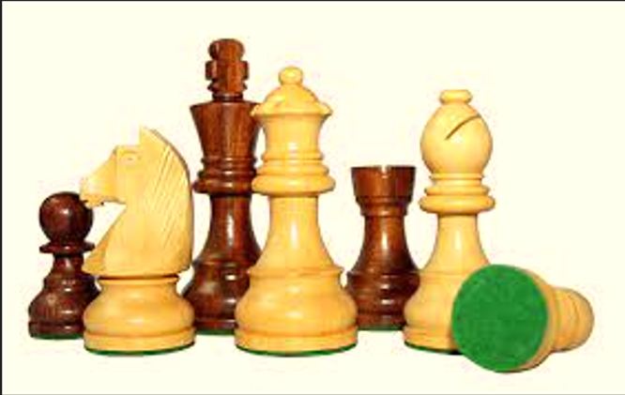
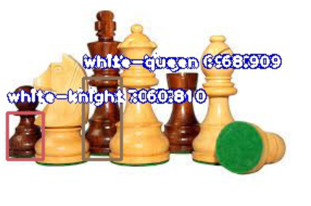
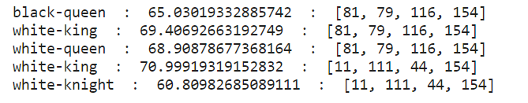
Prediction on Random Sample

Slide 17
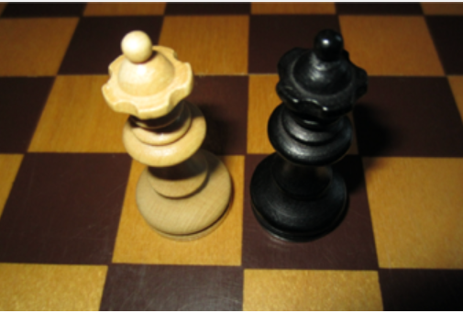
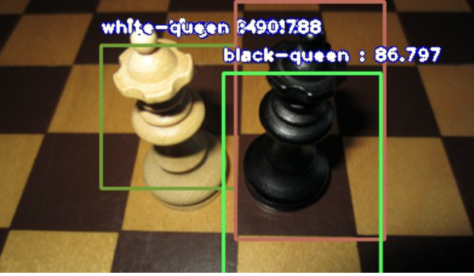
Detection For Similar Image

Slide 18
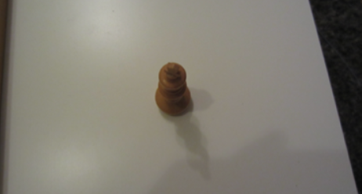
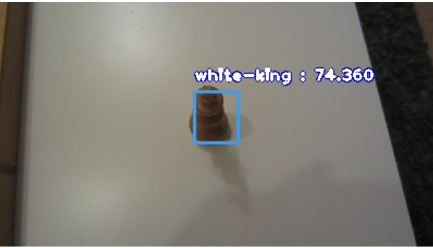
Detection from top view

Slide 19
References
https://pjreddie.com/media/files/papers/YOLOv3.pdf
https://imageai.readthedocs.io/en/latest/
https://medium.com/analytics-vidhya/iou-intersection-over-union-705a39e7acef
https://manivannan-ai.medium.com/how-to-train-yolov3-to-detect-custom-objects-ccbcafeb13d2
https://www.researchgate.net/publication/325803364_A_Study_on_CNN_Transfer_Learning_for_Image_Classification/
https://machinelearningmastery.com/transfer-learning-for-deep-learning/

Slide 20
THANK YOU!

